Slide 1


Slide 2

An Innovative, Multidisciplinary and Standardized
Treatment Protocol for Patients Suffering of Chronic Tinnitus:
Results for 3344 patients (2014 – 2022)
Alexandre-Claude TIMSIT, M.D.; ENT Specialist, Paris
Gerald FAIN, M.D.; ENT Specialist, Paris
Jérôme LEFEUVRE, Audioprothesist, Paris
Marc BOULET, Audioprothesist, Paris.
Jean-Pierre BEBEAR, Professor, ENT Specialist, Bordeaux
Jérôme NEVOUX, Professor, ENT Specialist, Paris
IFOS 2023 - Wednesday January 18, 2023 - DUBAI

Slide 3
Flow Chart
Patients in pre-recruitment: 4090
65 Patients not eligible (patients under 18, possible pregnancy, ear pathologies or surgery, patients already under antiepileptics)
175 patients comforted by explantions (use of the protocol unjustified)
506 lost to follow-up (refuse medical treatment or hearing aids, treatment interrupted for various reasons, no-show at appointments)
3.344 patients were definitively included and have received the full protocol.

Slide 4
Assessment of the results: 4 grades
Protocol is successful:
Grade 1: Complete recovery, disappareance of the tinnitus
VAS = 0 and THI < 5
Grade 2: Improvement, tinnitus does not embarrass me anymore, I wish to stop the treatment, I can live normally.
VAS < 3 and THI < 10.
Protocol failed:
Grade 3: I don’t see any difference, but nevertheless VAS and THI scores were improved of more than 50 % !!
Grade 4: Complete failure, no improvement.
IFOS 2023 - Wednesday January 18, 2023 - DUBAI

Slide 5
What else ?
Sleep
  Sleep disturbed 47,40 % (1582 patients)
  Sleep improved (after full protocol) 68,60 % (1092 / 1582)
Hyperacusis
  With hyperacusis 21,54 % (719 patients)
  Improved (after full protocol) 80,95 % (582 / 719)
Scores after the full protocol
  VAS reduced of more than 50 % : 3063 / 3344 patients 91,60 %
  THI reduced of more than 50 %: 2464 / 3344 patients 75,40 %
Psychiatric help necessary
  (VAS > 8 and THI > 80) 7,40 % patients (247/3344)
IFOS 2023 - Wednesday January 18, 2023 - DUBAI

Slide 6
Step 1 / 4 of our protocol
First consultation: listen carefully the complain of the patient, ask for previous audiometry, imaging and treatments for those patients prone to medical nomadism
Complete interrogation, personnal history and clinical examination
Evaluation of the characteristics of the tinnitus (whistling is the most frequent)
Evaluation of the impact of the tinnitus on patient’s daily life using the score of Visual Analogic Scale (VAS) and Tinnitus Handicap Inventory (THI) questionnary
Evaluation of the emotional level of the patient using the Hospital Anxiety and Depression (HAD) scale questionnary.
Make a pure tone (including high frequencies) and speech audiometry
CT scan, MRI or MRI 3 tesla when indicated.
IFOS 2023 - Wednesday January 18, 2023 - DUBAI

Slide 7
The Most Disturbing sounds
Clinking
Open tap
Sea backwash
Buzzing
Pure sound
Sizzling
Heartbeat
High voltage
Mix of different sounds
Pressure cooker
Rustle
Buzz
Cricket, Cicada
Whistling

Slide 8
Step 1 / 4 of our protocol
Take your time with the patient for a long and detailed explanation about what we know about the mechanisms leading to tinnitus
Tinnitus is due to an electric hyperactivation of the brain’s auditive area which is exactly the same mechanism occuring for pain.
Tinnitus is the consequence of a hearing loss visible (with classic audiometry) or invisible (with high definition audiometry) in more than 98 % of cases
No correlation found between hearing loss and the feeling of the tinnitus
But why all hearing losses do not lead to a tinnitus ?
IFOS 2023 - Wednesday January 18, 2023 - DUBAI

Slide 9
Step 2 / 4 of our Protocol
Prescription of antiepileptics:
  Justify the use of antiepileptics, often prescribed for major pains, and insist about the low rate of side effects
  Successive prescription of five different antiepileptic drugs in a specific order, at very low dosage, and for a limited duration (4 to 6 months)
  The failure of one molecule after one month (side effects or lack of efficiency) directly leads to its interruption and prescription of the next molecule of the list and so on
  In case of improvement with one molecule, prescription is extended after a complete blood check-up
  Strict follow-up of the patient (appointment, phone call or e-mails) and systematic evaluation (VAS and THI scores) every four to six weeks
IFOS 2023 - Wednesday January 18, 2023 - DUBAI

Slide 10
Order of prescription of antiepileptics
Molecule | Dosage | Nb of patients | Efficiency
Gabapentin | 300 to 600 mg /day | 94,03 % | 54,85 %
Carbamazepine | 200 mg / day | 39,60 | 54,22 %
Lamotrigine | 50 to 75 mg / day | 19,60 | 54,10 %
Topiramate | 50 to 75 mg / day | 7,72 | 55,70 %
Clonazepam | 3 to 10 drops / day | 20,35 | 55,30 %
IFOS 2023 - Wednesday January 18, 2023 - DUBAI

Slide 11
Step 3 / 4 of our Protocol
Prescription of hearing aids:
  Systematic prescription of sterophonic hearing aids as soon as possible, associated or not with antiepilepics
    immediately if hearing loss is severe,
    delayed for moderate or invisible hearing loss,
    or after failure of the medical treatment.
  The systematic use of High Definition Audiometry (frequency by 1/48e of octave and intensity by unstep of one dB) by our audioprothesisis is the key of a successful hearing aids fitting.
  After a High Definition Acouphenometry, we use inhibition by Lateral Amplification and/or colourful Noise depending the level and the type of hearing loss.
IFOS 2023 - Wednesday January 18, 2023 - DUBAI

Slide 12
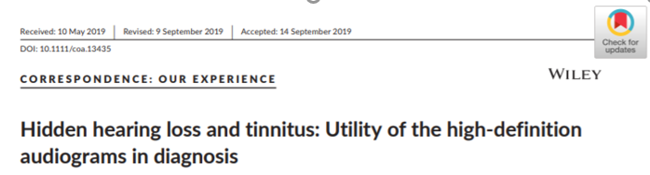
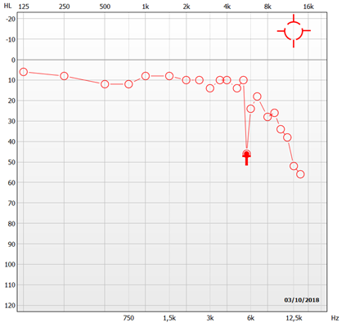
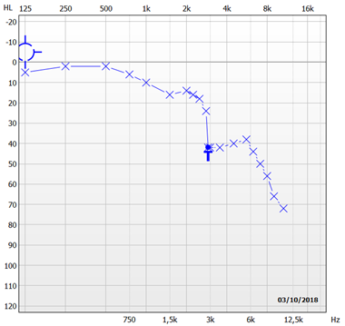
High Definition Audiometry
Lefeuvre J et al, Clin Otolaryngol, 2019
High Definition Audiometry( rounded to the nearest dB and Hz)
Invisible hearing loss:
Micro-slope = loss of 2.5 dB / 1/12ème of octave
Micro-scotome = scotome of more than 10 dB and
wide of less than ½ octave
Micro-scotome
Micro-slope
IFOS 2023 - Wednesday January 18, 2023 - DUBAI

Slide 13
Correlation
Lefeuvre J et al, Clin Otolaryngol, 2019
In this study, for 66 patients, the correlation between frequency of micro-scotome or micro-slope and frequency of the tinnutus reach 89 % (Pearson, R=0,990; p=0,0001).
Location of the tinnitus | Micro-scotome | Micro-slope | No Micro-loss or micro-scotome
Number of patients | 62, 1 % | 19, 7 %. | 18, 2 %
Average of hearing loss | 17 dB ± 12 dB [0 ; 38 ] | 21.25 dB ±5 dB [3.75 ; 38.75] | 25.25 dB ±6 dB [ 7.5 ; 36.25]
Frequency average of the tinnitus | 5260 Hz ± 155 Hz [ 2000 ; 12200] | 8750 Hz ± 3464 Hz [ 2400 ; 11200] | 7500 Hz ± 2121 Hz [ 2400 ; 11200]
Intensity average of the tinnitus | 3.5 dB ± 1.4 dB [ 1 ; 15] | 6.5 dB ±2.1 dB [ 1 ; 14] | 5.5 dB ± 0.7 dB [ 1 ; 14]
IFOS 2023 - Wednesday January 18, 2023 - DUBAI

Slide 14
Results Prosthetik
Solutions choisies
SATISFACTORY RATE
unsatisfied 7,6%
Lefeuvre J et al, Clin Otolaryngol, 2019
satisfied
92,4%
VAS and THI:
66 patients with whistling and without hearing loss directly equiped
(Difference statisticaly significative : t-Test ; p<0,0001)
Coloured noise alone
5,0 %
 | VAS Inconvenience (/10) | VAS Intensity (/10) | THI (/100)
Before equipment | 6,36 1,75 (2;10) | 6,27 1,63 (2;10) | 50,81 17 (12;80)
After Equipment | 3,63 1,70 (0;6) | 3,72 1,80 (0;6) | 28,95 11,69 (12;52)
IFOS 2023 - Wednesday January 18, 2023 - DUBAI
Notes:
Dans notre étude, les patients ont été appareillé, avec une amplification légères des sons faibles associé ou non à un bruit coloré. ( Le patient avait le choix grâce à plusieurs programmes).
92 % des patients ont ressenti une nette amélioration au bout d’un mois. Amélioration mesuré grâce au THI qui est passé en moyenne de 50 à 287 et à l’EVA qui est passé en moyenne de 6 à 3. Ces scores sons statistiquement significatifs.
CCL: A condition d’avoir réalisé une audiométrie HD, La prise en charge des patients acouphéniques par un appareillage auditif conventionnel, même en cas d’audition dite normale ou de surdité légère, diminue l’intensité des symptômes et doit être proposée à ces patients

Slide 15
Prescription of hearing aids:
Medical treatment alone: 1710 (51,14 %)
Hearing aids refused by the patient : 225 ( 6,73 %)
Prescription of hearing aids: 1409 (42,13 %)
Before medical treatment 247 (17,53 %)
Associated to medical treatment 388 (27,53 %)
After failure of the medical treatment 774 (54,94 %)
IFOS 2023 - Wednesday January 18, 2023 - DUBAI

Slide 16
Step 4 / 4 of our protocol
Take in account the emotional level of the patient and the real level of the impact of the tinnitus on daily life
Insist on the disponibility and the cohesion of our multidisciplinary team which can always be reached
According to each patient, the medical and audioprothetic care can be completed by the advice and the follow-up of psychologists, sophrologists, speech therapists of our team
In the most severe cases (high emotional level: VAS > 8 and THI > 80) we ask for the advice of a neuro-psychiatrist.
IFOS 2023 - Wednesday January 18, 2023 - DUBAI

Slide 17
Results for patients receiving the full protocol
67,75%
GRADE 2
33,50 %
32,25%
GRADE 4
13,3 %
GRADE 1
34,25 %
GRADE 3
18,95 %
IFOS 2023 - Wednesday January 18, 2023 - DUBAI

Slide 18
Results in accordance with each Protocol
 | P 1: Medical Tt + Hearing aids 1267 / 3344 37,90 % | P 2: Medical treatment alone 1796 / 3344 53,70 % | P 3: Hearing aids alone 281 / 3344 8,40 %
Grade 1 | 495 39,10 % | 553 30,80 % | 85 30,10 %
Grade 2 | 463 36,50 % | 604 33,60 % | 86 30,70 %
Grade 1 + 2 | 958 patients 75,60 % | 1.157 patients 64,40 % | 171 patients 60,80 %
Grade 3 | 212 16,70 % | 295 16,40 % | 71 25,30 %
Grade 4 | 97 7,70 % | 344 19,20 % | 39 13,90 %
Grade 3 + 4 | 309 Patients 24,40 % | 639 Patients 35,60 % | 110 Patients 39,20 %
IFOS 2023 - Wednesday January 18, 2023 - DUBAI

Slide 19
Conclusions and take home message
Take your time during the first consultation: listen and explain. Some patients do not need any treatment and only need to be comforted with clear explanations.
Emotional level must always be taken in account
Antiepileptic medication is generally well accepted with clear and coherent explanations (very rare side effects: <2 %: muscular pain, hitching)
Prescription of hearing aids must be prescribed as soon as possible, even for invisible or light hearing losses
We have to point out the importance of the multidisciplinary team even if the ENT specialist always remain the coordinator
The rate of improvement (67,60 %) allow us to propose this protocol for all patients
suffering of chronic tinnitus
IFOS 2023 - Wednesday January 18, 2023 - DUBAI

Slide 20


The autors declare that they have no competing interest
THANK YOU
AND HAVE A NICE MEETING !
IFOS 2023 - Wednesday January 18, 2023 - DUBAI

